Slide 1
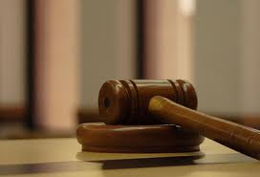
To Sue or to Sew
1 Corinthians 6:1-11
Dr. Rick Griffith • Crossroads International Church Singapore
cicfamily.com & BibleStudyDownloads.org

Slide 2
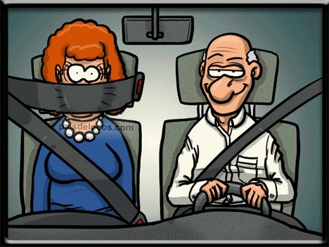

New Seat Belt Law
New Seat Belt Law became effective November 1, 2007. The National Highway Safety Council has done extensive testing on a newly designed seat belt. Results show that accidents can be reduced by as much as 45% when the belt is properly installed. Correct installation is illustrated here. This is very important. Please pass on to friends and family. THIS MAY SAVE A LIFE!

Slide 3
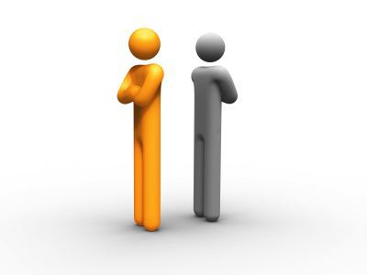
Have you had conflict?

Slide 4

Why bring this up?

Slide 5
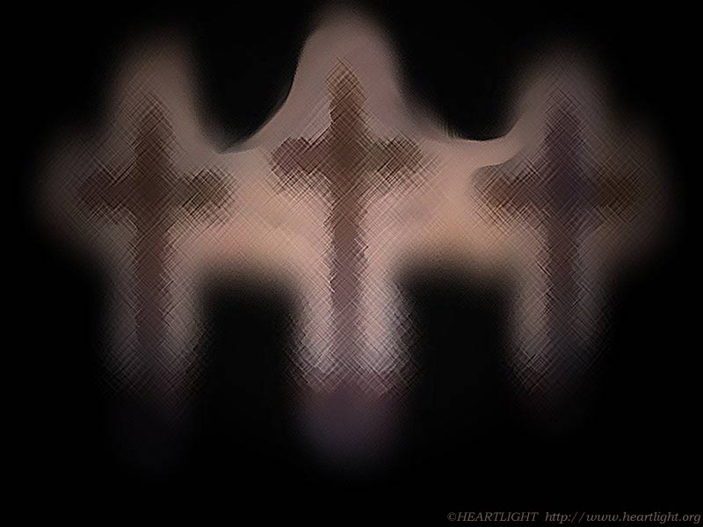
Conflicts among Christians are family matters––not for unbelievers to solve (6:1)
Why?
Competency
Witness

Slide 6
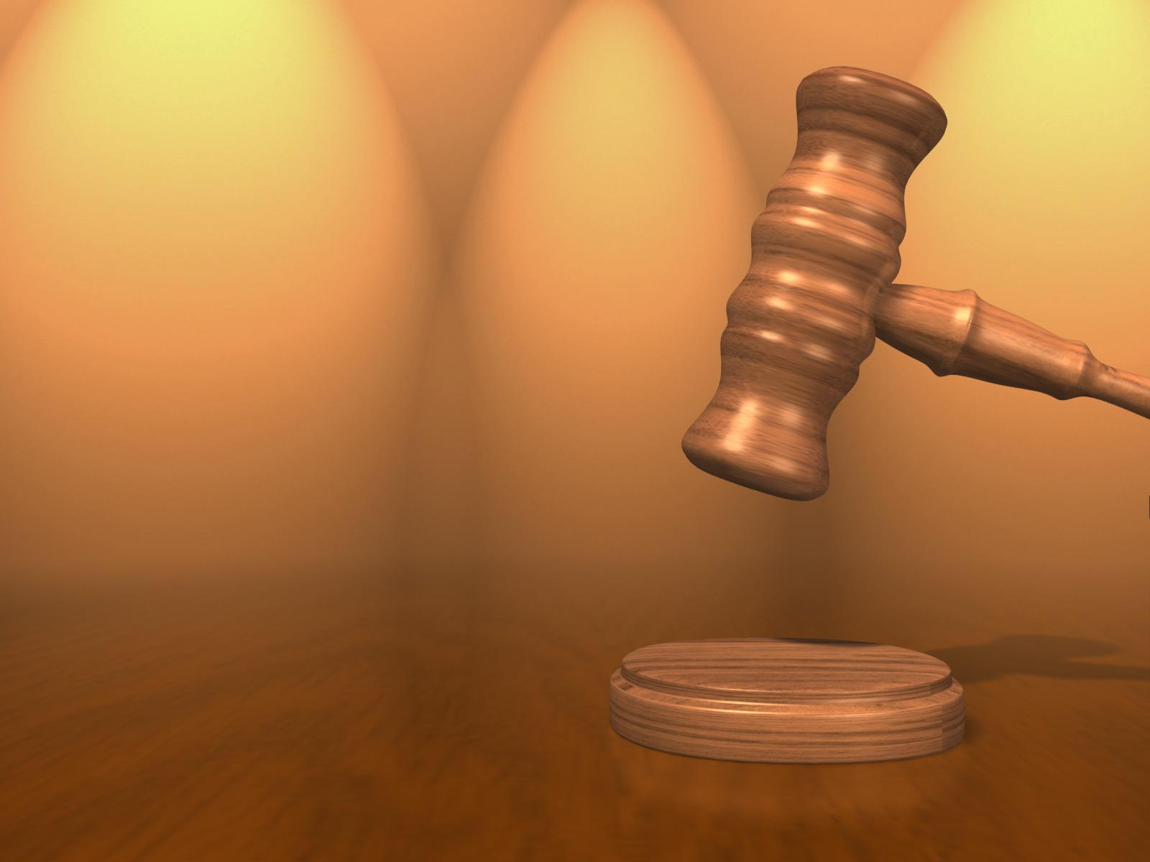
I. We are more competent than unbelievers to solve Christian disputes
(2-6, 9-11)

Slide 7
“Do you not know that saints will judge the world?”
(6:2a)

Slide 8

The Rule of Christ
What is it? When is it?

Slide 9



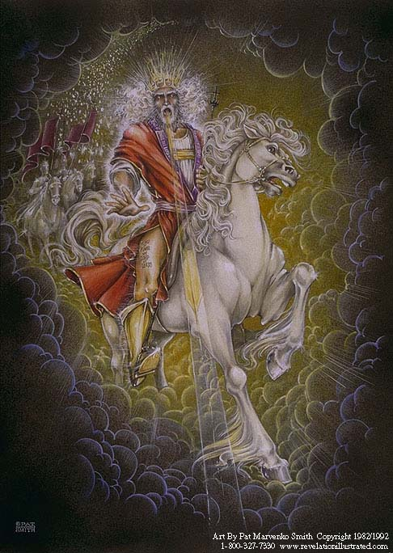
Our Future
(Rev. 19-20)
Heaven
(Rev. 21-22)
Millennium
(Rev. 20)
Return
(Rev. 19)

Slide 10
Revelation 20:4 (NAU)
⁴Then I saw thrones, and they sat on them, and judgment was given to them. And I saw the souls of those who had been beheaded because of their testimony of Jesus and because of the word of God, and those who had not worshiped the beast or his image, and had not received the mark on their forehead and on their hand; and they came to life and reigned with Christ for a thousand years.

Slide 11
Black

Slide 12
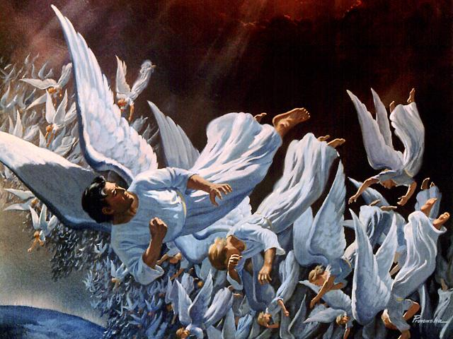
"Then this further message came to me from the LORD: ¹²'Son of man, sing this funeral song for the king of Tyre. Give him this message from the Sovereign LORD:
"You were the model of perfection, full of wisdom and exquisite in beauty. ¹³You were in Eden, the garden of God.
Your clothing was adorned with every precious stone…
all beautifully crafted for you and set in the finest gold.
They were given to you on the day you were created"'"
(Ezek. 28:11-13)
Fall of Lucifer, the Shining Star (cf. Rev. 12:7-9)‏

Slide 13
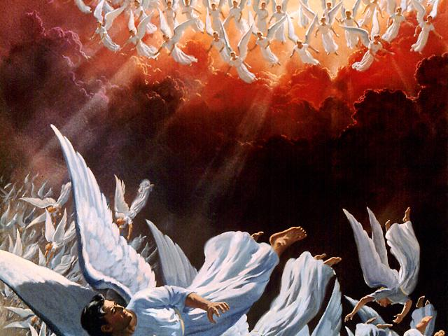
The angels pursue
¹⁵ "You were blameless in all you did from the day you were created until the day evil was found in you.
¹⁶ Your rich commerce led you to violence,
and you sinned.
So I banished you in disgrace
from the mountain of God.
I expelled you, O mighty guardian,
from your place among the stones of fire.
¹⁷ Your heart was filled with pride
because of all your beauty.
Your wisdom was corrupted
by your love of splendor.
So I threw you to the ground and
exposed you to the curious gaze of kings"
(Ezek. 28:12-17)‏

Slide 14
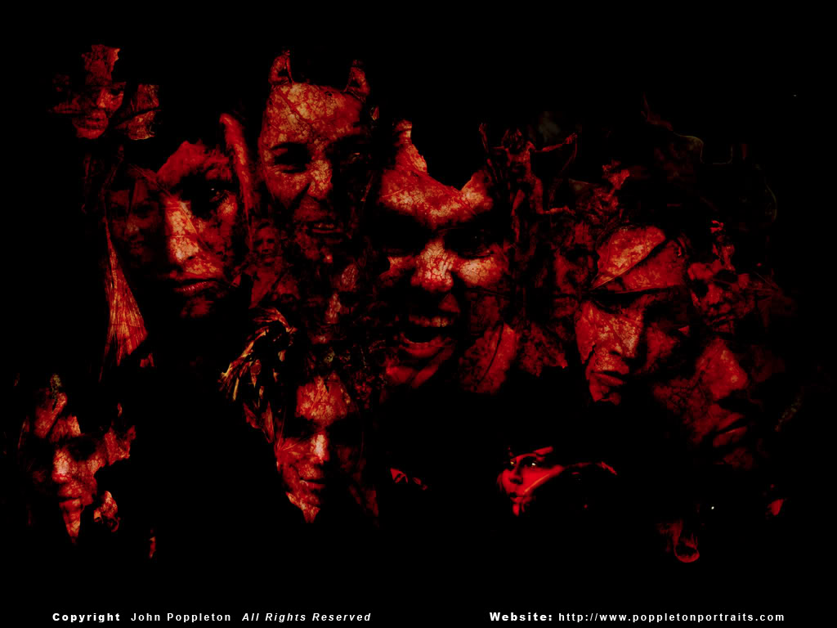
We will Judge Fallen Angels (Demons)

Slide 15
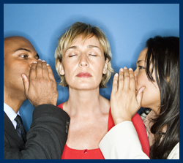
Even inexperienced Christians judge church affairs better than non-Christians (4-6)
Not-so-influential (4)
Not-so-wise (5-6)

Slide 16


Salvation and sanctification are more important in making judgments than expertise (9-11)

Slide 17

Why do we go to unbelievers for judgment?
Wealth over Witness
Pride over Prince
Unjustified over Justified
Courts more Equitable?

Slide 18
I. We are more competent than unbelievers to solve Christian disputes
(2-6, 9-11)

Slide 19
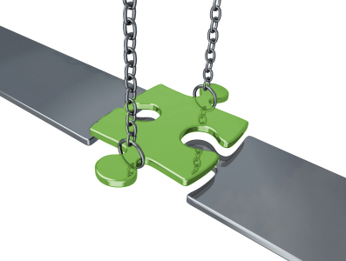
II. It is better to suffer personal loss than for the whole church lose its witness (7-8)

Slide 20
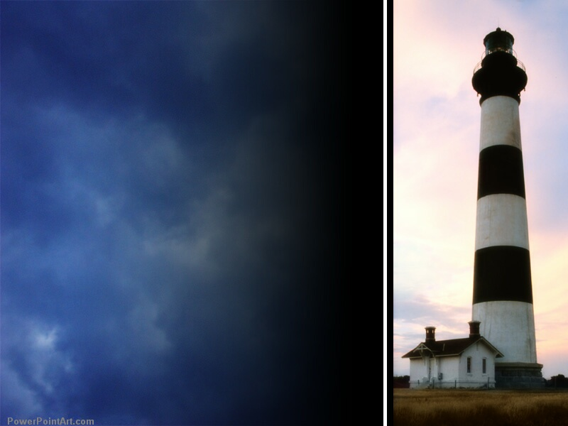
“You are the light of the world…”

Slide 21
How to win by losing
A. Better that one Christian
be wronged than the church
be wronged from litigating saints (7)
B. Better to lose money than
to lose ministry opportunities by cheating other Christians (8)

Slide 22
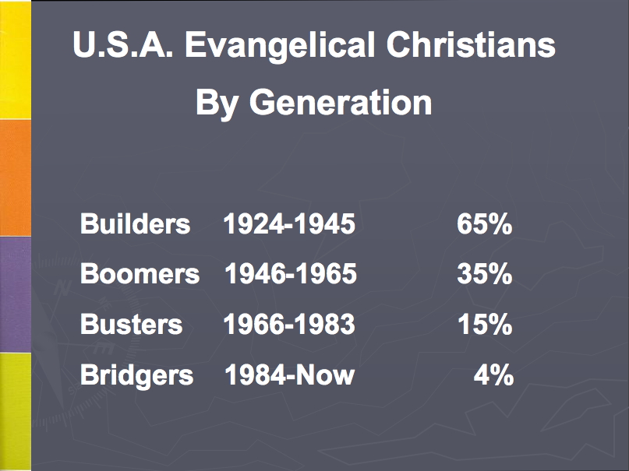
Church Attendance
Notes:
22
22

Slide 23
Black

Slide 24
I. We are more competent than unbelievers to solve Christian disputes
(2-6, 9-11)

Slide 25
II. It is better to suffer personal loss than for the whole church lose its witness (7-8)

Slide 26
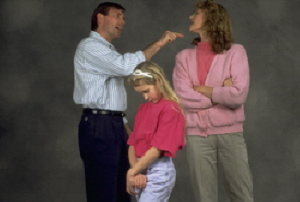
III. Let us apply this principle to some special situations today…

Slide 27
Special Situations
What if you’re legally right?
What if the issue is a criminal offense?
Is it OK to claim against a Christian’s insurance company?
Can Christians sue non-Christians?
Can we defend ourselves if another believer litigates against us?

Slide 28
Black

Slide 29
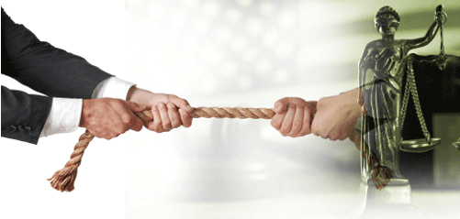
Main Idea:
Disputes between believers must be solved by believers

Slide 30

Church Covenant
    As members of one body, we pledge to:
    (xiv) resolve all conflicts with arbitration only among believers without recourse to the secular courts

Slide 31

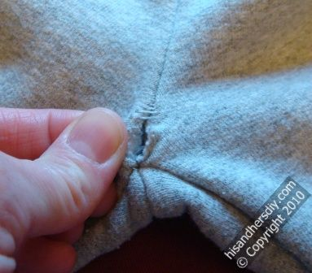
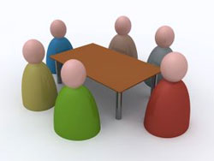
Sue?
Or Sew?

Slide 32
Black

Slide 33


NT Preaching link at BibleStudyDownloads.org
Get this presentation and script for free!
Notes:
NT Preaching (np)

